Slide 1
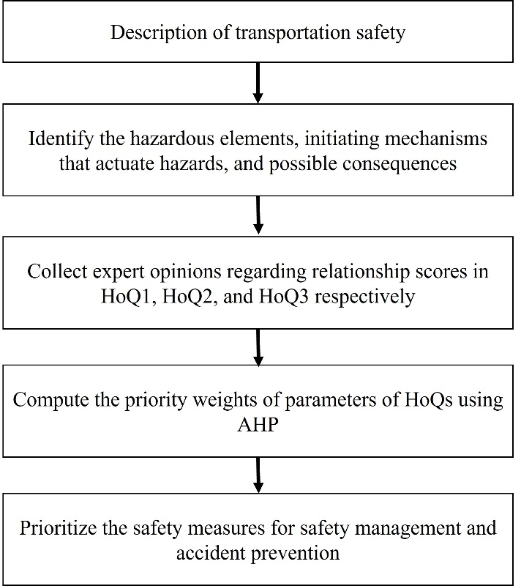
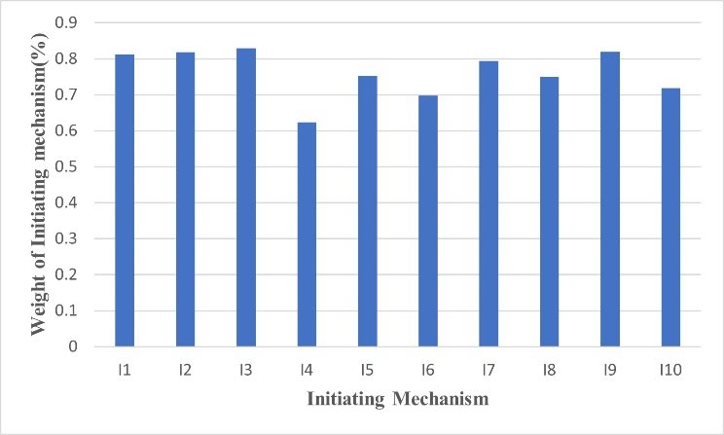
Centre of Excellence in Safety Engineering and Analytics (CoE-SEA), IIT Kharagpur
International Conference on “Safety, Health and Analytics-Driven Governance for Sustainable Development” (SHADG 2024)
IIT KHARAGPUR
Title of Poster
First Author¹, Second Author², Third Author^{1,2, *}
¹First affiliation, Address, City and Postcode, Country
²Second affiliation, Address, City and Postcode, Country
*Provide full correspondence details here including e-mail for the corresponding author
Heading 1
Heading 2
Heading 3
Heading 4
This system safety ontology further leads us to implement an SFD approach for analysis and risk assessment.
This paper reported a safety function deployment model for the analysis and prioritization of safety barriers in the road transportation system.
• This strategy will help from understanding the system to the pathway of risk management.
• The described methodology integrates quality function deployment with the analytic hierarchy process to develop a safety function deployment approach.
• This strategy will assist in implementing safety criteria for mitigating and preventing hazards during road transportation.
The normalized weight of the safety measures is tabulated and presented in Figure
The associated relationships between these three components are represented in this study using a QFD framework. The pairwise comparison is derived from the AHP and is employed to compute the weights of elements for submatrices.
Funding and Acknowledgment
References (restricted to four)
Reference one
Reference two
Reference three
Reference four

